Slide 1
Eight Common Traits of Remarkably Successful People
By Priyanka Mehta
December 29, 2013

Slide 2
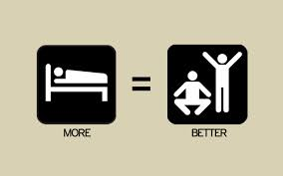

1. Remarkably successful people don’t create back-up plans
There are both positive and negative thoughts about creating back-up plans. Some people that are not that successful state that back-up plans help them sleep at night. They also create an easier way out when you need a way to get out of a problem.
Other people that are successful know that if there is a back-up plan they would not work harder or longer because there is another option. Total commitment is needed to succeed in life.

Slide 3



2. They do the work
You might of heard from your parents that if you work harder you will do a lot better. Well this is true. You can be good with a little effort but you can be even better with a little more effort. You can’t be good at anything if you do not try. You have to put a hundred percent of your effort into doing something to succeed in what your trying to learn or do. Use your time wisely because time is running out.
Genius is one percent inspiration, ninety-nine percent perspiration.
-Thomas Edison

Slide 4


3. They work a lot more
The successful people in life work a lot more hours than an average person. If you look at a successful person’s schedule they have a longer list of things they want or have to get done. This encourages them to put in more time to accomplish what is on there list of what they have to do.
Shockingly, successful people want to put in lots of time. This keeps them active and accomplish more in life.

Slide 5
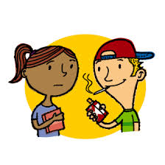

4. They avoid the crowds.
Many people that are in a “group” tend to fall behind in what they should be doing.
Being in a group depends on what type of group you may be in. You could be in a good group saying that you would not get into trouble or you would stay on task and not let the group you are in change you. There are also bad groups of people you can be influenced by. By joining a group your attitude or judgment of doing the right thing could change. It is your choice whether or not you would like to be in a good or bad group.
Successful people in life like to be unique and do things that others would not do. They do things that others would not do so there would not be as much competition and there would be a greater chance for success.

Slide 6


5. They start at the end
Have you ever had to solve a maze and have been told to start from the end and work your way up. Well that is how people succeed in life. As they say, average success is based on average goals. Wherever you want to end up is your goal.
After you have your goal set up you can work backwards and lay out every step of the way. The average person will start small and then work their way up while a successful person will already have everything planned out so they don’t have to worry about what they have to do next. You will make better decisions and you will find that it is easier to work harder when you reach your ultimate goal.

Slide 7
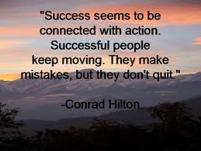

6. They don’t stop there
The average person would achieve a goal but just end there. A successful person turns one achievement or goal into another. Achieving one goal is just the beginning for achieving another goal that could be bigger. They use things that they have learned and they use that knowledge to learn and accomplish other things in life too.
“Remarkably successful people don’t try to win just one race. They expect and plan to win a number of races.”

Slide 8


7. They sell
If you want to become a businessman or anything in life you have to sell yourself. This means you have to put your best foot out there and convince others you know exactly what you are doing and you are great at it.
Many successful people that are business owners and CEOs stated that their ability to sell contributed the most of their success. Selling is convincing other people to work and agree with you. The ability to say or deal with “no” helps maintain confidence and self-esteem in the face of rejection.

Slide 9

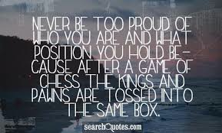
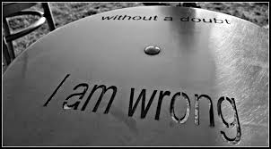
8. They are never too proud
Remarkable successful people are never too proud. They never feel too proud to admit a mistake or to say that they are sorry. They never make or give a person the wrong impression. Successful people never let their emotions get to them or other people. If they do make a mistake they will just try again.

Slide 10

This can be summed up by Swami Vivekananda’s divine message for youth as our goal in life…

Slide 11
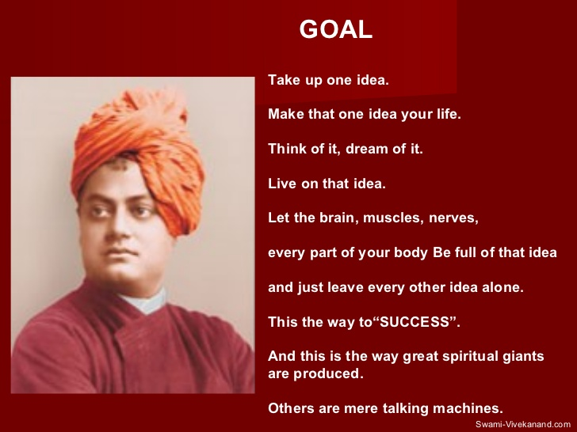

Slide 12
Thank you!

